Slide 1
Chapter 2 :Sets

Slide 2
Topic Outcomes
Explain the significance of Sets and functions in computer science.
Apply the appropriate set operations for solving the given problems.
Identify the nature of function for the given problem.
Identify the given set is countable or uncountable.

Slide 3
Contents
Introduction
Set Operations
Functions: One-to-One Functions
Onto Functions
Inverse Functions
Compositions of Functions
Cardinality

Slide 4
Why Sets?
Discrete structures are built using sets , they are :
Programming Language: uses Data types
Combinations: unordered collections of objects used extensively in counting(Computer Networks)
Relations: sets of ordered pairs that represent relationships between objects(Database Management system)
Graphs: sets of vertices and edges that connect vertices(Computer Networks)
Finite state machines: used to model computing machines.(Theory of Computations)

Slide 5

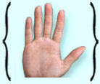
Introduction
A set is a collection or group of objects or elements or members. (Cantor 1895)
The objects in a set are called the elements or the members, of the set.
A set is said to contain its elements.
Set of fingers Set of Primary colours
.

Slide 6
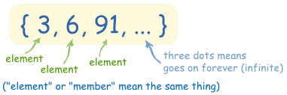
Definition: A set is an unordered collection of objects

Slide 7
Notation:
x is a member of S or x is an element of S:
x ∈ S.
x is not an element of S:
x ∉ S.
Ways to describe set:
List the elements between braces: S = {a, b, c, d}={b, c, a, d, d}-Raster notation
The set of vowels in the English alphabet V={a,e,i,o,u}.
The set of all whole numbers less than ten R={0,1,2,3,4,5,6,7,8,9}
Specification using set builder notation.(when it is not practical to list all the elements of a set.
O= {x|x is an odd positive integer less than 10).

Slide 8
Activity on Set builder notation
List the members of the sets.
(i) {x : x is an even natural numbers less than 12}
(ii) {x : x is a prime numbers less than 12}
(iii) {x : x is a month whose name starts with letter J}
(iv) {x : x is a natural number upto 30 and divisible by 5}
Write the following sets in Set-Builder Form or Rule form
(i) A = {1, 3 5, 7, 9}
(ii) B = {16, 25, 36, 49, 64}
(iii) C = {a, e, i, o, u}
(iv) D = {violet, indigo, blue, green, yellow, orange, red}
(v) E = {January, March, May, July, August, October, December}

Slide 9
Equal sets
Two sets are equal if and only if they have the same elements. Therefore, if A and B are sets,then A and B are equal if and only if ∀x(x ∈ A ↔ x ∈ B).We write A = B if A and B are equal sets.
The sets {1, 3, 5} and {3, 5, 1} are equal.
Note :The order in which the elements of a set are listed does not matter and also an element of a set can appear many times, i.e {1, 3, 3, 3, 5, 5, 5, 5}={1, 3, 5} .

Slide 10
Types of sets
Empty Set or Null Set:
Singleton Set:
Finite Set:
Infinite Set:

Slide 11
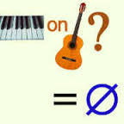
Empty Set
A set which does not contain any element is called an empty set, or the null set and it is denoted by ∅ (read as phi).
In roster form, ∅ is denoted by {}.
An empty set is a finite set, since the number of elements in an empty set is finite, i.e., 0.
Ex:(i)The set of whole numbers less than 0.
(ii)N = {x : x ∈ N, 3 < x < 4}.
(iii)The set of all positive integers that are greater than their
squares is the null set.
Note:
∅ ≠ {0} ∴ has no element. {0} is a set which has one element 0.

Slide 12
Singleton Set
A set with one element is called a singleton set.
Is{∅}=∅?
Ex: Folders in a computer file system.
Empty set ==empty folder
Singleton set==folder with exactly one folder inside,
namely, the empty folder.
B={x:x is a whole number, x < 1}
A = {x : x ∈ N and x² = 4}
The singleton set {3} is the set whose only element is 3.
The singleton set {{3}} is the set whose only element is {3}.

Slide 13
Activity
1.Determine whether each of these statements is true or false.
a) x ∈ {x} b) {x} ⊆ {x} c) {x} ∈ {x}
d) {x} ∈ {{x}} e) ∅ ⊆ {x} f ) ∅ ∈ {x}
2.Determine whether these statements are true or false.
a) ∅ ∈ {∅} b) ∅ ∈ {∅, {∅}}
c) {∅} ∈ {∅} d) {∅} ∈ {{∅}}
e) {∅} ⊂ {∅, {∅}} f ) {{∅}} ⊂ {∅, {∅}}
g) {{∅}} ⊂ {{∅}, {∅}}

Slide 14
Venn Diagram
Sets can be represented graphically using Venn diagrams, named after the English mathematician John Venn in 1881.
In Venn diagrams the universal set U,, is represented by a rectangle, which contains all the objects under consideration Inside this rectangle, circles or other geometrical figures are used to represent sets.
Points are used to represent the particular elements of the set.
Venn diagrams are also used to indicate the relationships between sets.

Slide 15
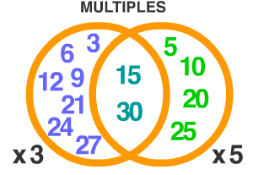
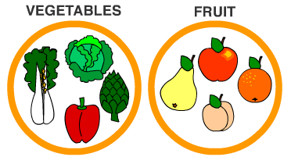
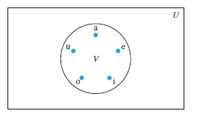
Vowels

Slide 16
Common Universal Sets
R = The set of real numbers
N = natural numbers = {0,1, 2, 3, . . . }, the counting numbers
Z = all integers = {. . , -3, -2, -1, 0, 1, 2, 3, 4, . .}
Z+ ={1,2,3,…} is the set of positive integers
Data type or type is built upon the concept name of a set.
Ex: boolean is the set {0,1}
Definition: Two sets are equal if and only if they have the same elements. i.e ∀x [x ∈ A ↔ x ∈ B].A=B if A and B are equal sets.
Ex:{1,3,5} and{3,5,1}are equal—order does not matter.
Also(1,3,3,5,5,5,3,1}={1,3,5}—element can appear more than once.

Slide 17


Universal Set
There must be an underlying universal set.
A Universal Set is the set of all elements under consideration, denoted by capital U.
It's a set that contains everything that is relevant to our question. Ex: In Calculus the universal set is almost always the real numbers. And in number theory always the universal set is the integers.
U={{alex, blair, casey, drew, erin, francis, glen, hunter, ira, jade}-Set of all players(football and hockey)

Slide 18
Activity
1.Use a Venn diagram to illustrate the set of all months of the year whose names do not contain the letter R in the set of all months of the year.
2.Use a Venn diagram to illustrate the relationships A ⊂ B and B ⊂ C.

Slide 19
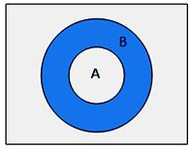
Subsets
If A and B are two sets, and every element of set A is also an element of set B, then A is called a subset of B and we write it as A ⊆ B or B ⊇ A , iff ∀x [x ∈ A → x ∈ B].
• Every set is a subset of itself, i.e., A ⊆ A, B ⊆ B.
• Empty set is a subset of every set. ∅ ⊆ S
• Symbol ‘⊆’ is used to denote ‘is a subset of’ or ‘is contained in’.
A = {1, 3, 4} and B = {1, 4, 3, 2} then, A is a subset of B

Slide 20
Examples
The set of all odd positive integers less than 10 is a subset of the set of all positive integers less than 10
The set of rational numbers is a subset of the set of real numbers,
The set of all computer science majors at your school is a subset of the set of all students at your school,
The set of all people in India is a subset of the set of all people in India(that is, it is a subset of itself).

Slide 21
Proper subset
A is a proper subset of B if and only if every element in A is also in B, and there exists at least one element in B that is not in A.
i.e If A ⊆ B but A ≠ B the we say A is a proper subset of B, denoted A ⊂ B . ∀x [x ∈ A ↔ x ∈ B]Λ ∃ [x ∈ B ↔ x ∉A ]
Is {1, 2, 3} is a subset of {1, 2, 3}, but is not a proper subset of {1, 2, 3}.
{1, 2, 3} is a proper subset of {1, 2, 3, 4} because the element 4 is not in the first set.

Slide 22
Activity
1. Find the number of proper subsets of the following.
P = {x : x ∈ N, x < 5}
(b) Q = {x : x is an even prime number}
(c) R = {x : x ∈ W, x < 2}
d) T = { }
(e) X = {0}
(f) Y = {x : x is prime, 2 < x < 10}
2.Let A be the set of letters of the word FOLLOW. Find Number of subsets of A and Number of proper subsets of A.

Slide 23
Size of a set
Let S be a set. If there are exactly n distinct elements in S where n is a nonnegative integer, we say that S is a finite set and that n is the cardinality of S. The cardinality of S is denoted by |S|.
Ex: Let A be the set of odd positive integers less than 10. Then |A| = 5.
Let S be the set of letters in the English alphabet. Then |S| = 26.
The null set has no elements, it follows that |∅| = 0
A set is said to be infinite if it is not finite.
Ex: The set of positive integers is infinite.

Slide 24
Finite Set:
A set which contains a definite number of elements is called a finite set. Empty set is also called a finite set.
Ex: The set of all colors in the rainbow.
N = {x : x ∈ N, x < 7}
P = {2, 3, 5, 7, 11, 13, 17, ...... 97}
Infinite Set:
The set whose elements cannot be listed, i.e., set containing never-ending elements is called an infinite set.
Ex:
A = {x : x ∈ N, x > 1}
Set of all prime numbers
B = {x : x ∈ W, x = 2n}
Note: All infinite sets cannot be expressed in roster form.

Slide 25
Power sets
Given a set S, the power set of S is the set of all subsets of the set S. The power set of S is denoted by P(S).
If the original set has n members, then the Power Set will have 2^{n} members.
Ex: The set A={ a, b, c}, consists of three members(a,b and c).
Then P(A) 2³ = 8.{Ø,{a},{b},{c},{a,b},{b,c},{c,a},{a,b,c}}
Notation
The number of members of a set is often written as |S|, so we can write:|P(S)| = 2^{n}
Example: for the set S={1,2,3,4,5} how many members will the power set have?
|P(S)| = 2^{n}=2⁵⁼³²

Slide 26
Set Operations
Arithmetic operators (+,-, × ,÷) can be used on pairs of numbers to give us new numbers.
Similarly, set operators exist and act on two sets to give us new sets. They are
Union
Intersection
Set difference
Set complement
Generalized union
Generlized intersection

Slide 27
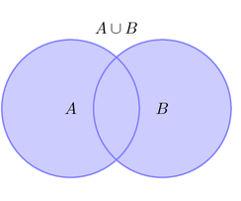
UNION
Let A and B be sets. The Union of the sets A and B, denoted by A⋃B, is the set contains those elements that are either in A or in B or both.
A ⋃ B={x|x ∈ A ⋁ x ∈ B}
The symbol for denoting union of sets is ‘∪’.
Venn Diagram:

Slide 28
Example
Let set A = {2, 4, 5, 6}and set B = {4, 6, 7, 8}
A⋃B = {2, 4, 5, 6, 7, 8}
If A = {1, 3, 7, 5} and B = {3, 7, 8, 9}. Find union of two set A and B.
A ∪ B = {1, 3, 5, 7, 8, 9} Note:No element is repeated in the union of two sets. The common elements 3, 7 are taken only once.

Slide 29
Activity
1. If set P = {2, 3, 4, 5, 6, 7}, set Q = {0, 3, 6, 9, 12} and set R ={2, 4, 6, 8}.
(i) Find the union of sets P and Q,(ii) Find the union of two set P and R, (iii) Find the union of the given sets Q and R
2. Let X = {a, e, i, o, u} and Y = {ф}. Find union of two given sets X and Y.

Slide 30
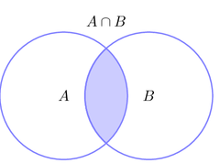
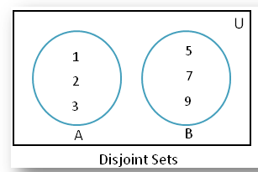
Intersection
Let A and B be sets. The intersection of A and B, denoted by A∩B, is the set containing those elements that are in both A and B. A ⋂ B={x|x ∈ A ⋀ x ∈ B}
The symbol for denoting intersection of sets is ‘⋂’.
Venn Diagram:
Two sets are called disjoint if their intersection is empty set.
A={1,2,3} B={5,7,9},then A⋂B=Ø

Slide 31
Example
Let set A = {2, 3, 4, 5, 6} and set B = {3, 5, 7, 9}A⋂B={3,5} is the intersection of set A and B.3,5 are common elements.
If A = {2, 4, 6, 8, 10} and B = {1, 3, 8, 4, 6}. Find intersection of two set A and B.
A ∩ B = {4, 6, 8}
4, 6 and 8 are the common elements in both the sets.

Slide 32
Activity
1. If X = {a, b, c} and Y = {ф}. Find intersection of two given sets X and Y.
2. If set A = {4, 6, 8, 10, 12}, set B = {3, 6, 9, 12, 15, 18} and set C = {1, 2, 3, 4, 5, 6, 7, 8, 9, 10}.
(i) Find the intersection of sets A and B.
(ii) Find the intersection of two set B and C.
(iii) Find the intersection of the given sets A and C.

Slide 33
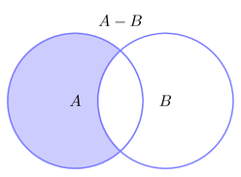
Set difference
Let A and B be sets. The difference of A and B, denoted by A-B, is the set containing those elements that are in A but not in B. (complement of B with respect to A.
A - B={x|x ∈ A ⋀ x ∉B}
The symbol for denoting difference of sets is ‘-’.
Venn diagram:

Slide 34
Example
• If A = {2, 3, 4} and B = {4, 5, 6}.Then
A - B = {2, 3}
A = {1, 2, 3} and B = {4, 5, 6}. Then
A -B={1,2,3}.
B –A={4,5,6}

Slide 35
Activity
1. Let A = {a, b, c, d, e, f} and B = {b, d, f, g}.Find the difference between the two sets:(i) A and B,(ii) B and A.
2. Given three sets P, Q and R such that:
P = {x : x is a natural number between 10 and 16},
Q = {y : y is a even number between 8 and 20} and
R = {7, 9, 11, 14, 18, 20}
(i) Find the difference of two sets P and Q
(ii) Find Q - R
(iii) Find R - P
(iv) Find Q – P

Slide 36
Set complement
Let U be the universal set. The complement of the set A denoted by Ā, ,is the complement of A with respect to U. i.e Ā =U-A={x|x ∉A}
We denote the complement Ā of A with respect to U as
Venn diagram:
Ā
Ā
U
A

Slide 37
Example
If U = {1, 2, 3, 4, 5, 6, 7},A = {1, 3, 7} find A'. We observe that 2, 4, 5, 6 are the only elements of U which do not belong to A. Therefore, Ā = {2, 4, 5, 6}.
Note:
The complement of a universal set is an empty set.
The complement of an empty set is a universal set.
The set and its complement are disjoint sets.
Let A={a,e,i,o,u} and U=set of letters of the English alphabet,then
Ā={b,c,d,f,g,h,j,k,l,m,n,o,p,q,r,s,t,v,w,x,y,z}.

Slide 38
Activity
1. Let the set of natural numbers be the universal set and A is a set of even natural numbers. Find Ā.
2. Show that the complement of a universal set is an empty set.
3. A set and its complement are disjoint sets.
4. Let U = {2, 4, 6, 8, 10, 12, 14, 16} and A = {6, 10, 4, 16}.Find Ā

Slide 39
Activity
Find the union of each of the following pairs of sets.
(a) A = {2, 4, 6} ,B = {1, 2, 3} ,
(b) P = {a, e, i, o, u} , Q = {a, b, c, d}
2. X = {x : n ∈ N, x = 2n, n < 4} ,Y = {x : x is an even number less than 10}.
3. M = {x : x is natural number and multiple of 3},N = {x : x is a prime number less than 19}.
4. D = {x : x is an integer -3 < x < 3} ,E = {x : x is a factor of 8}.
5.G = {x : x ∈ N, x < 7}, H = {x : x ∈ Z, -2 ≤ x ≤ 3}.

Slide 40
Activity
1. Find the intersection of each of the following pairs of sets.
(a) A = {1, 4, 9, 16}, B = {3, 6, 9, 12}.
(b) C = {p, q, r, s}, D = {a, b} .
(c) P = {x : n ∈ N, x = 3n n< 3},Q = {x : x ∈ N x < 7}.
(d) X = {x : x is a letter of the word ‘LOYAL’}, Y = {x : x is a letter in the word ‘FLOW’}.
(e) G = {x : x = n2, when n ∈ N} ,H = {x : x = 4n, when n ∈ W n < 5}.

Slide 41
Activity
If A = {a, b, c, d} B = {b, c, d, e} C = {c, d, e, f} D = {d, e, f, g}, find (a) A – B (b) B – C (c) C – D (d) D – A (e) B - A
2.. Let U = {1, 2, 3, 4, 5, 6, 7, 8, 9, 10},A = {1, 2, 4, 6, 8, 10} B = {1, 3, 5, 7, 8, 9}Find: (a) A‘ (b) B‘ (c) A' ∪ B’,(d) A' ∩ B‘
(e)show(A ∪ B)' = A' ∩ B‘.
3. Find the complement of the following sets if universal set is the set of natural numbers.
(a) {x : x is a prime number},(b) {x : x is a multiple of 2},(c) {x : x is a perfect cube},(d) {x : x ≥ 10} ,(e) {x : x Є N, 5x + 1 > 20} (f) {x : x is an odd natural number}.
4 If U = {a, b, c, d, e, f} find the complement of the following.
(a) A = { },(b) B = {c, d, f} (c) D = {a, b, c, d, e, f},(d) C = {a, b, d} e) E = {b, c} ,(f) F = {a, c, f}

Slide 42
8. If U = {1, 2, 3, 4, 5, 6} and A = {2, 3, 6}, find
(a) A ∪ A‘ (b) ∅ ∩ A
(c) A ∩ A’, (d) U' ∩ A.
9. Let P = {1, 3, 5, 7} Q = {3, 7, 9, 11} R = {1, 5, 8, 11}, then verify the following.
(a) P ∪ Q = Q ∪ P, (b) (P ∪ Q) ∪ R = P ∪ (Q ∪ R) ,
(c) P ∩ Q = Q ∩P (d) (P ∩ Q) ∩ R = P ∩ (Q ∩ R) ,
(e) P ∩ (Q ∪ R) = (P ∩ Q) ∪ (P ∩ R) .
10. Let U = {a, b, c, d, e, f, g}, A = {a, c ,f , g}, B = {f, g, b, d}
Verify: (a) (A ∪ B)' = (A' ∩ B') , (b) (A ∩ B)' = (A' ∪ B')

Slide 43
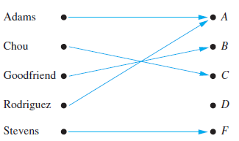
Functions
Let A and B be nonempty sets. A function f from A to B, is an assignment of exactly one element of B to each element of A. We write f(a)=b if b is the unique element of B assigned by the function f to the element a of A. If f is a function from A to B then it is denoted as f :A→B.
Assignment of a grade to a student is an example of function.
Multiply by 2 is a simple function.
Functions can also be called as mappings or transformations.

Slide 44
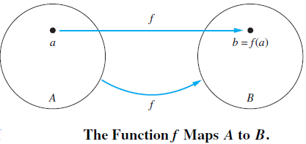
Definition:
If f is a function from A to B, then
A is called the domain of f
B is called the codomain of f
If f(a) = b
b is called the image of a under f
a is called a preimage of b
(Note: There may be more than one preimage of b but there is only one image of a).
The range of f is the set of all images of points in A under f. We denote it by f(A). i.e f maps A to B

Slide 45
If S is a subset of A then
f(S) = {f(s) | s in S}.
Example:
• f(a) = Z
• the image of d is Z
• the domain of f is A = {a, b, c, d}
• the codomain is B = {X, Y, Z}
• f(A) = {Y, Z}
• the preimage of Y is b
• the preimages of Z are a, c and d
• f({c,d}) = {Z}
A
B
a
X
b
Y
c
Z
d

Slide 46
What are the domain, codomain and range of the function that assigns grades to students described below

Slide 47
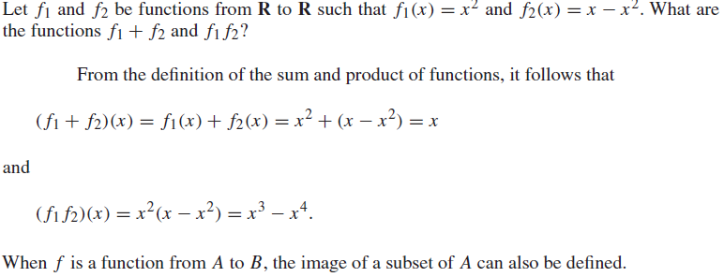
Let f1 and f2 be functions from A to R. Then f1+f2 and f1f2 are also functions from A to R defined by
(f1+f2)(X)=f1(x)+f2(x).
(f1f2)(x)=f1(x)f2(x).
Value of x in terms of f1 and f2 are specified.
Example:

Slide 48
One-to-One
A function f is said to be one-to-one or injective if and only if f(a)=f(b) implies that a=b for all a and b in the domain of A.A function is said to be an injection if it is one-to-one.i.e f(a)≠f(b) whenever a≠b
A
f
B

Slide 49
Determine whether the function f from{ a,b,c,d} to {1,2,3,4,5} with f(a)=4,f(b)=5,f(c)=1 and f(d)=3 is one-to-one?
Determine whether the function f(x)=x2 from the set of integers to the set of integers is one-to-one.

Slide 50
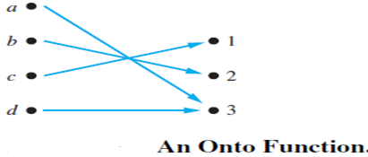
Onto or surjective
A function f from A to B is called onto or surjective if and only if for every elements b∈ B there is an element a ∈A with f(a)=b. A function f is called a surjection if it is onto.

Slide 51
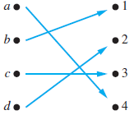
Bijection
The function f is a one-to-one correspondence or a bijection, if it is both one-to-one and onto.

Slide 52
Activity
Classify the following functions between natural numbers as one-to-one and onto.
Define functions f from Z to Z and g from R to R by the formulas: for all y ∊Z and x ∊ R, f(y) = y² and g(x) = 2x + 1
a. Is f onto? Prove or disprove by giving a counter example.
b. Is g onto? Prove or disprove by giving a counter example.
f_{j} | One-to-One | Onto
f₁(n)=n²
f₂(n)=n+3
f₃(n)= n-1,odd n n+1,even n

Slide 53
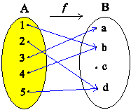
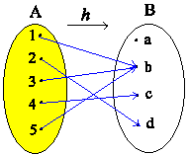
Let A = {1, 2, 3, 4, 5} and B = {a, b, c, d}. Which of the following arrow diagram(s) defines onto functions? Explain

Slide 54
Give an explicit formula for a function from the set of integers to the set of positive integers that is
a) one-to-one, but not onto.
b) onto, but not one-to-one.
c) one-to-one and onto.
d) neither one-to-one nor onto
Determine whether each of these functions is a bijection
from R to R.
a) f (x) = 2x + 1
b) f (x) = x2 + 1
c) f (x) = (x2 + 1)/(x2 + 2)

Slide 55
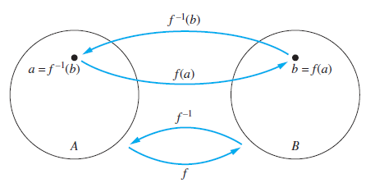
Inverse function
Let f be a one-to-one correspondence from the set A to the set B. The inverse function of f is the function that assigns to an element b belonging to B the unique element a in A such that f(a)=b. The inverse function of f is denoted by f⁻¹ .Hence f⁻¹(b)=a when f(a)=b.
A function which is one-to-one correspondence is called invertible and it is not invertible if it is not one-to-one correspondence.

Slide 56
Activity
Let f be the function from R to R defined by f (x) = x2. Find
a) f−1({1}).
b) f−1({x | 0 < x < 1}).
c) f −1({x | x > 4}).
Let f be a function from A to B. Let S and T be subsets of B. Show that
a) f−1(S ∪ T ) = f−1(S) ∪ f−1(T ).
b) f−1(S ∩ T ) = f−1(S) ∩ f−1(T ).

Slide 57
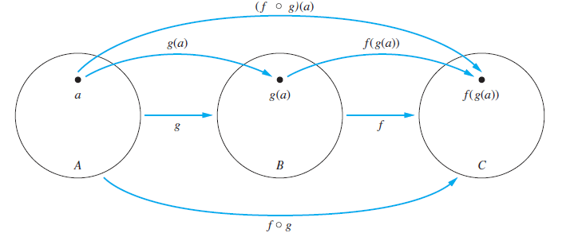
Composition
Let g be a function from the set A to the set B and let f be a function from the set B to the set C. The composition of the functions f and g, denoted by ( fog)(a)=f(g(a)).

Slide 58
Activity
Find f ◦ g and g ◦ f , where f (x) = x2 + 1 and g(x) =x + 2, are functions from R to R.
Find f + g and fg for the functions f and g given in above Exercise .
Let g be the function from the set {a, b, c} to itself such that g(a) = b, g(b) = c, and g(c) = a.Let f be the function from the set {a, b, c} to the set {1, 2, 3} such that f (a) = 3, f (b) = 2, andf (c) = 1. What is the composition of f and g, and what is the composition of g and f ?

Slide 59

Relation
2021-22

Slide 60
Topic Outcomes
Explain the significance of relations in the field of computer science.
List and classify the relations on a set using different properties with suitable examples.
Find the Composition of the relations.
Demonstrate with an example how to represent Relations using matrices and Diagraphs.
Find closure of relation.
Draw Hasse diagram for a given poset.

Slide 61
Contents
Relations and their properties
Representing Relations
Closures of Relations
Equivalence Relations
Partial Orderings

Slide 62
Introduction
Relationship between elements of sets occur in many contexts. Ex: Society, Mathematics, Programming Languages
Relationship between elements of sets are represented using the structure called relation.
Example: i) Rachel is the daughter of Noah.
ii) 5 is less than 9.
iii) Let A and B denote the set animals and their young
ones. A = {cat, dog, cow, goat}, B = {kitten, puppy,
calf, kid},The relation (R) being ‘is young one of ‘.
iv) Relation between a function and a variable.

Slide 63
Relations and their properties
A relationship between elements of two sets is represented using ordered pairs.
sets of ordered pairs are called binary relations.
Binary Relation
Let A and B be sets. A binary relation from A to B is a subset R of A× B = { (a, b) : a∈A, b∈B }.
Example
A : the set of students in your school.
B : the set of courses.
R = { (a, b) : a∈A, b∈B, a is enrolled in course b }

Slide 64
Example
Let P be a set of people, C be a set of cars, and D be the relation describing which person drives which car(s).
P = {Carl, Suzanne, Peter, Carla}, C = {Mercedes, BMW, tricycle}
D = {(Carl, Mercedes), (Suzanne, Mercedes),(Suzanne, BMW), (Peter, tricycle)}

Slide 65
Relation: We use the notation aRb to denote that (a, b)∈R, and aRb to denote that (a,b)∉R.Moreover, a is said to be related to b by R if aRb.
Example Let A={0, 1, 2} and B={a, b}, then {(0,a),(0,b),(1,a),(2,b)} is a relation R from A to B.This means, for instance, that 0Ra, but that 1Rb.
A
R ⊆ A×B = { (0,a) , (0,b) , (1,a)
(1,b) , (2,a) , (2,b)}
B
0
a
∈R
∈R
1
b
2
R

Slide 66
Functions as Relations
A function f from a set A to a set B assigns a unique element of B to each element of A.
The graph of f is the set of ordered pairs (a, b) such that b = f(a).
The graph of f is a subset of A×B, it is a relation from A to B.
For each element a of A, there is exactly one ordered pair in the graph that has a as its first element.
Conversely, if R is a relation from A to B such that every element in A is the first element of exactly one ordered pair of R, then a function can be defined with R as its graph.
This is done by assigning to an element a∈A the unique element b∈B such that (a, b)∈R.

Slide 67
Relations on a set
A relation on the set A is a subset of A × A( i.e., a relation from A to A ).
Example: Let A be the set {1, 2, 3, 4}. Which ordered pairs are in the relation R = { (a, b)| a divides b }?
Activity:

Slide 68
Sol :
1
1
2
2
3
3
4
4
R = { (1,1), (1,2), (1,3), (1,4),(2,2), (2,4),(3,3), (4,4) }

Slide 69
Activity
Let A be the set {0,1, 2, 3, 4} and B be the set{0,1,2,3},where (a,b)∊R if and only if
A)a=b b)a>b. Which ordered pairs are in the relation R ?
ii Let A = {1, 2, 3, 4}. Define a relation R on A by writing (x, y) R if x < y.
iii Consider these relations on the set of integers:
R1 = {(a, b) | a ≤ b},
R2 = {(a, b) | a > b},
R3 = {(a, b) | a = b or a = −b},
R4 = {(a, b) | a = b},
R5 = {(a, b) | a = b + 1},
R6 = {(a, b) | a + b ≤ 3}.
Which of these relations contain each of the pairs (1, 1), (1, 2), (2, 1), (1,−1), and (2, 2)?
iv . Define a relation L from R to R as follows: For all real numbers x and y, x L y x < y.
a. Is 57 L 53? b. Is (−17) L (−14)? c. Is 143 L 143? d. Is (−35) L 1?

Slide 70
Properties of Relations
Important properties are:
Reflexive
Symmetric
Antisymmetric
Transitive
These properties are used to classify relations on set.

Slide 71
Reflexive: A relation R on a set A is called reflexive if (a,a)∈R for every a∈A.i.e ∀a((a,a) ∈R)
Symmetric: A relation R on a set A is called symmetric if for a, b∈A, (a, b)∈R ⇒ (b, a)∈R. ∀a ∀b((a,b)∈R→(b,a)∈R)
Antisymmetric: A relation R on a set A is called antisymmetric if for a, b∈A, (a, b)∈R and (b, a)∈R ⇒ a = b. i.e., a≠b and (a,b)∈R⇒(b, a)∉R
Transitive: A relation R on a set A is called transitive if for a, b, c ∈A, (a, b)∈R and (b, c)∈R ⇒ (a, c)∈R.

Slide 72
Activity
i.Let A = {0, 1, 2, 3} and define relations R, S, and T on A as follows:R = {(0, 0), (0, 1), (0, 3),(1, 0), (1, 1), (2, 2), (3, 0),(3, 3)},
S = {(0, 0), (0, 2), (0, 3), (2, 3)},T = {(0, 1), (2, 3)}.
a. Is R reflexive? symmetric? transitive?
b. Is S reflexive? symmetric? transitive?
c. Is T reflexive? symmetric? transitive?
ii. Define a relation R on the integers by aRb if a²-b²≤ 3.List the properties satisfied by R.
iii. Check whether the following relation is reflexive? Symmetric or transitive?
ab≥0

Slide 73
Combining Relations
R₁ ∪ R₂
R₁ ∩ R₂
R₁ － R₂
R₂ － R₁
R₁ ⊕ R₂

Slide 74
Let A = {1, 2, 3} and B = {1, 2, 3, 4}.The relation R₁ ={(1,1), (2,2), (3,3)} and R₂ = {(1,1), (1,2), (1,3), (1,4)} can be combined to obtain
R₁ ∪ R₂ = {(1,1), (2,2), (3,3), (1,2), (1,3), (1,4)}
R₁ ∩ R₂ = {(1,1)}
R₁ － R₂ = {(2,2), (3,3)}
R₂ － R₁ = {(1,2), (1,3), (1,4)}
R₁ ⊕ R₂ = {(2,2), (3,3), (1,2), (1,3), (1,4)}
symmetric difference,(R₁∪R₂) – (R₁∩ R₂)

Slide 75
Let R1 be the “less than” relation on the set of real numbers and let R2 be the “greater than” relation on the set of real numbers, that is, R1 = {(x, y) | x < y} and R2 = {(x, y) | x > y}.What are R1 ∪ R2, R1 ∩ R2, R1 − R2, R2 − R1, and R1 ⊕ R2
Find a) R1 ∪ R3. b) R2 ∩ R4. c) R1 − R2 .d) R1 ⊕ R3. h)
R1 = {(a, b) ∈ R2 | a > b}, the “greater than” relation,
R2 = {(a, b) ∈ R2 | a ≥ b}, the “greater than or equal to” relation,
R3 = {(a, b) ∈ R2 | a < b}, the “less than” relation,
R4 = {(a, b) ∈ R2 | a ≤ b}, the “less than or equal to” Relation,

Slide 76
Composition: Let R be a relation from a set A to a set B and S a relation from B to a set C. The composite of R and S is the relation consisting of ordered pairs (a,c), where a∈A, c∈C, and for which there exists an element b∈B such that (a,b)∈R and (b,c)∈S. We denote the composite of R and S by S °R.
Activity
What is the composite of relations R and S, where R is the relation from {1, 2, 3} to {1, 2, 3, 4} with R = {(1, 1), (1, 4), (2, 3), (3, 1), (3, 4)} and S is the relation from {1, 2, 3, 4} to {0, 1, 2} with S = {(1, 0), (2, 0), (3, 1), (3, 2), (4, 1)}?
Find a) R1 ◦ R1. b) R1 ◦ R2. c) R1 ◦ R3. d) R1 ◦ R4. usind previous R1,R2,R3 and R4

Slide 77
Composing the parent relation with itself:
Let R be a relation on the set A. The powers R^{n}, n = 1, 2, 3, …, are defined recursively by R¹ = R and R^{n+1} = R^{n} °R
Example: Let R = {(1, 1), (2, 1), (3, 2), (4, 3)}.Find the powers R^{n}, n=2, 3, 4,….
Sol. R² = R °R = {(1, 1), (2, 1), (3, 1), (4, 2)}.
R³ = R² °R = {(1, 1), (2, 1), (3, 1), (4, 1)}.
R⁴ = R³ °R = {(1, 1), (2, 1), (3, 1), (4, 1)} = R³.
Therefore R^{n} = R³ for n=4, 5, ….

Slide 78
Activity
Let R be the relation on the set {1, 2, 3, 4, 5} containing the ordered pairs (1, 1), (1, 2), (1, 3), (2, 3), (2, 4), (3, 1), (3, 4), (3, 5), (4, 2), (4, 5), (5, 1), (5, 2), and (5, 4). Find a) R2. b) R3. c) R4. d) R5.

Slide 79
Representing Relations
Matrices
Graphs

Slide 80
Representing Relations using Matrices
Suppose that R is a relation from A={a₁, a₂, …, a_{m}} to B = {b₁, b₂,…, b_{n} }.The relation R can be represented by the matrix M_{R} = [m_{ij}], where
1, if (a_{i},b_{j})∈R
m_{ij} =
0, if (a_{i},b_{j})∉R

Slide 81
Example 1. Suppose that A = {1, 2, 3} and B = {1, 2}. Let R = {(a, b) | a > b, a∈A, b∈B}. What is the matrix M_{R} representing R?
Sol :
R = {(2, 1), (3, 1), (3, 2)}
B
1
2
1
0
0
A
2
1
0
3
1
1

Slide 82
Let A={a₁, a₂, …,a_{n}}. A relation R on A is reflexive iff (a_{i},a_{i})∈R,∀i.
i.e.,
…
…
a₁
a₂
a_{n}
a₁
a₂
:
:
a_{n}
The relation R is symmetric iff (a_{i},a_{j})∈R ⇒ (a_{j},a_{i})∈R. This means m_{ij} = m_{ji} .

Slide 83
The relation R is antisymmetric iff (a_{i},a_{j})∈R and i ≠ j ⇒ (a_{j},a_{i})∉R.
This means that if mij=1 with i≠j, then mji=0. i.e.,

Slide 84
Example 3. Suppose that the relation R on a set is represented by the matrix
Is R reflexive, symmetric, and/or antisymmetric ?
Sol :
reflexive
symmetric
not antisymmetric

Slide 85
Example: Suppose that S={0, 1, 2, 3}. Let R be a relation containing (a, b) if a ≤ b, where a ∈ S and b ∈ S.Is R reflexive, symmetric, antisymmetric ?
Sol :
0
1
2
3
0
1
∴ R is reflexive and ant symmetric,
not symmetric.
2
3
Def. irreflexive : (a,a)∉R, ∀a∈A

Slide 86
Example 4. Suppose the relations R₁ and R₂ on a set A are represented by the matrices
What are the matrices representing R1 ∪ R2 and R1 ∩ R2?
Sol :

Slide 87
Example 5. Find the matrix representing the relation S°R, where the matrices representing R and S are
Sol :


Slide 88
Example 6. Find the matrix representing the relation R², where the matrix representing R is
Sol :

Slide 89
Representing Relations using Digraphs
Definition 1. A directed graph (digraph) consists of a set V of vertices (or nodes) together with a set E of ordered pairs of elements of V called edges (or arcs).
Example 8.
Show the digraph of the relation R={(1,1),(1,3),(2,1),(2,3),(2,4),(3,1),(3,2),(4,1)} on the set {1,2,3,4}.
Sol :
vertex : 1, 2, 3, 4
edge : (1,1), (1,3), (2,1), (2,3), (2,4), (3,1), (3,2),(4,1)
1
2
4
3

Slide 90
The relation R is reflexive iff for every vertex,
The relation R is symmetric iff for any vertices x≠y, either
or
x
y
x
y
The relation R is antisymmetric iff for any x≠y,
or
or
x
y
x
y
x
y

Slide 91
The relation R is transitive iff for a, b, c ∈A, (a, b)∈R and (b, c)∈R ⇒ (a, c)∈R.This means:
a
b
a
b
⇒
d
c
d
c

Slide 92
Example 10. Determine whether the relations R and S are reflexive, symmetric, antisymmetric, and/or transitive
a
b
Sol :
S
R :
c
d
a
reflexive,
not symmetric,
not antisymmetric,
not transitive
(a→b, b→c, a→c)
not reflexive,
symmetric
not antisymmetric
not transitive
(b→a, a→c, b→c)
b
c

Slide 93
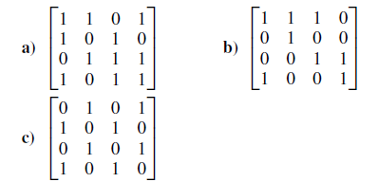
Activity
Represent each of these relations on {1, 2, 3, 4} with a matrix (with the elements of this set listed in increasing order).
a) {(1, 2), (1, 3), (1, 4), (2, 3), (2, 4), (3, 4)}
b) {(1, 1), (1, 4), (2, 2), (3, 3), (4, 1)}
c) {(1, 2), (1, 3), (1, 4), (2, 1), (2, 3), (2, 4), (3, 1), (3, 2),(3, 4), (4, 1), (4, 2), (4, 3)}
Determine whether the relations represented by the matrices are reflexive, irreflexive, symmetric, antisymmetric, and/or transitive.

Slide 94
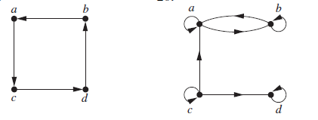
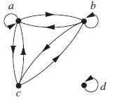

List the ordered pairs in the relations represented by directed graphs.

Slide 95
Closures of Relations
Let R be a relation on a set A. R may or may not have some property P, such as reflexivity, symmetry, or transitivity. If there is a relation S with property P containing R such that S is a subset of every relation with property P containing R, then S is called the closure of R with respect to P.
i.e The closure of a relation R with respect to property P is the relation obtained by adding the minimum number of ordered pairs to R to obtain property P.

Slide 96
The relation R={(1,1), (1,2), (2,1), (3,2)} on the set A={1, 2, 3} is not reflexive.
Q: How to construct a smallest reflexive relation containing R that is small as possible?
Sol: Let R_{r} = R ∪ {(2,2), (3,3)}.
i. e., R_{r} = R ∪ Δ, where Δ={(a, a)| a ∈ A}.
R_{r} is a reflexive relation containing R that is as small as possible. It is called the reflexive closure of R.

Slide 97
Definitions :
1.(reflexive closure of R on A)
R_{r}=the smallest reflexive relation containing R.
R_{r}=R∪{ (a, a) | a∈A , (a, a)∉R}
2.(symmetric closure of R on A)
R_{s}=the smallest symmetric relation containing R.
R_{s}=R∪{ (b, a) | (a, b)∈R and (b, a) ∉R}
3.(transitive closure of R on A)
R_{t}=the smallest transitive relation containing R.
R_{t}=R∪{(a, c) | (a, b)∈R_{t} and (b, c)∈R_{t}, but (a, c)∉R_{t}}(repeat)

Slide 98
Example:What is the reflexive closure of the relation R={(a,b) | a < b} on the set of integers ?
Sol : R_{r} = R ∪ D = {(a,b) | a < b} ∪ { (a, a) | a∈Z }
= { (a, b) | a ≤ b, a, b∈Z }
Example :
The relation R={ (1,1),(1,2),(2,2),(2,3),(3,1),(3,2) } on the set A={1,2,3} is not symmetric. Find a smallest symmetric relation R_{s} containing R.
Sol : Let R⁻¹={ (b, a) | (a, b)∈R }
Let R_{s}= R∪R⁻¹={ (1,1),(1,2),(2,1),(2,2),(2,3),
(3,1),(1,3),(3,2) }
R_{s} is called the symmetric closure of R.

Slide 99
Paths in Directed Graphs
Representing relations by directed graphs helps in the construction of transitive closures.
A path in a directed graph is obtained by traversing along edges (in the same direction as indicated by the arrow on the edge).

Slide 100
Definition:
A path from a to b in the directed graph G is a sequence of edges (x0, x1), (x1, x2), (x2, x3), . . . , (xn−1, xn) in G, where n is a nonnegative integer, and x0 = a and xn = b, that is, a sequence of edges where the terminal vertex of an edge is the same as the initial vertex in the next edge in the path. This path is denoted by x0, x1, x2, . . . , xn−1, xn and has length n. We view the empty set of edges as a path of length zero from a to a. A path of length n ≥ 1 that begins and ends at the same vertex is called a circuit or cycle.
A path in a directed graph can pass through a vertex more than once. Moreover, an edge in a directed graph can occur more than once in a path.

Slide 101
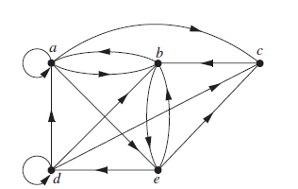
Which of the following are paths in the directed graph shown in Figure 1: a, b, e, d; a, e, c, d, b;b, a, c, b, a, a, b; d, c; c, b, a; e, b, a, b, a, b, e? What are the lengths of those that are paths?Which of the paths in this list are circuits?

Slide 102
i.e A path from a to b in the digraph G is a sequence of edges (x₀, x₁), (x₁, x₂), …, (x_{n-1}, x_{n}) in G, where n∈Z⁺, and x₀= a, x_{n}= b. This path is denoted by x₀, x₁, x₂, …, x_{n} and has length n.
Ex.
1
2
3
4
5
A path from 1 to 5 of length 4
Theorem 1 Let R be a relation on a set A. There is a path of length n, where n∈Z⁺, from a to b if and only if (a, b) ∈ R^{n}.
Ch8-102
Notes:
102

Slide 103
Transitive Closures
Def 2. Let R be a relation on a set A. The connectivity relation R* consists of pairs (a, b) such that there is a path of length at least one from a to b in R.
i.e.,
Theorem 2 The transitive closure of a relation R equals the connectivity relation R*.
Lemma 1 Let R be a relation on a set A with |A|=n. then
Ch8-103
Notes:
103

Slide 104
Example. Let R be a relation on a set A, where
A={1,2,3,4,5}, R={(1,2),(2,3),(3,4),(4,5)}.
What is the transitive closure R_{t} of R ?
Sol :
1
∴R_{t} = R ∪ R² ∪ R³ ∪ R⁴ ∪ R⁵
= {(1,2),(2,3),(3,4),(4,5),
(1,3), (2,4), (3,5),
(1,4), (2,5),
(1,5)}
3
5
2
4

Slide 105
Theorem 3 Let M_{R} be the zero-one matrix of the relation R on a set with n elements. Then the zero-one matrix of the transitive closure R* is
Example 7. Find the zero-one matrix of the transitive closure of the relation R where Sol :
Exercise: 25
Ch8-105

Slide 106
Equivalence Relations
A relation R on a set A is called an equivalence
relation if it is reflexive, symmetric, and transitive.
Example 1.
Let R be the relation on the set of integers such that aRb if and only if a=b or a=−b. Then R is an equivalence relation.
Example 2.
Let R be the relation on the set of real numbers such that aRb if and only if a−b is an integer. Then R is an equivalence relation.

Slide 107
Example 3. (Congruence Modulo m)
Let m ∈ Z and m > 1. Show that the relation
R={ (a,b) | a≡b (mod m) } is an equivalence relation on the set of integers.
( a is congruent to b modulo m, a
Sol :
Note that a≡b(mod m) iff m | (a-b).
∵① a≡a (mod m) ⇒ (a, a)∈R ⇒ reflexive
② If a≡b(mod m), then a-b=km, k∈Z
⇒ b-a= (-k)m ⇒ b≡a (mod m) ⇒ symmetric
③ If a≡b(mod m), b≡c(mod m)
then a-b=km, b-c=lm
⇒ a-c=(k+l)m ⇒ a≡c(mod m) ⇒ transitive
∴ R is an equivalence relation.

Slide 108
Example 4.
Let l(x) denote the length of the string x.
Suppose that the relation
R={(a,b) | l(a)=l(b), a,b are strings of English letters }
Is R an equivalence relation?
Sol :
① (a,a)∈R ∀string a ⇒ reflexive
② (a,b)∈R ⇒ (b,a)∈R ⇒ symmetric
Yes.
③ (a,b)∈R,(b,c)∈R ⇒ (a,c)∈R ⇒ transitive
Ch8-108
Notes:
108

Slide 109
Example 7.
Let R be the relation on the set of real numbers such that xRy if and only if x and y differ by less than 1, that is |x− y| < 1. Show that R is not an equivalence relation.
Sol :
① xRx ∀x since x− x =0 ⇒ reflexive
② xRy ⇒ |x− y| < 1 ⇒ |y− x| < 1 ⇒ yRx ⇒ symmetric
③ xRy, yRz ⇒ |x− y| < 1, |y− z| < 1 ⇒ |x− z| < 1 ⇒ Not transitive

Ch8-109
Notes:
109

Slide 110
Partial Orderings
A relation R on a set S is called a partial ordering or partial order if it is reflexive, antisymmetric, and transitive. A set S together with a partial ordering R is called a partially ordered set, or poset, and is denoted by (S, R).
Example 1.
Show that the “greater than or equal” (≥) is a partial ordering on the set of integers.
Sol :
① x ≥ x ∀x∈Z ⇒ reflexive
② If x ≥ y and y ≥ x then x = y. ⇒ antisymmetric
③ x ≥ y, y ≥ z ⇒ x ≥ z ⇒ transitive

Slide 111
Definition 2.
The elements a and b of a poset (S, ) are called comparable if either a b or b a. When a and b are elements of S such that neither a b or b a, a and b are called incomparable.
Example 5.
In the poset (Z⁺, |), are the integers 3 and 9 comparable? Are 5 and 7 comparable?
Sol :
3|9 ⇒ comparable
5 | 7 and 7 | 5 ⇒ incomparable
Ch8-111
Notes:
111

Slide 112
Definition 3. If (S, ) is a poset and every two elements of S are comparable, S is called a totally ordered or linearly ordered set, and is called a total order or a linear order. A totally ordered set is also called a chain.
Example 6.
The poset (Z, ≤) is totally ordered, because a ≤ b or b ≤ a whenever a and b are integers.
Example 7.
The poset (Z⁺, |) is not totally ordered.
Ch8-112
Notes:
112

Slide 113
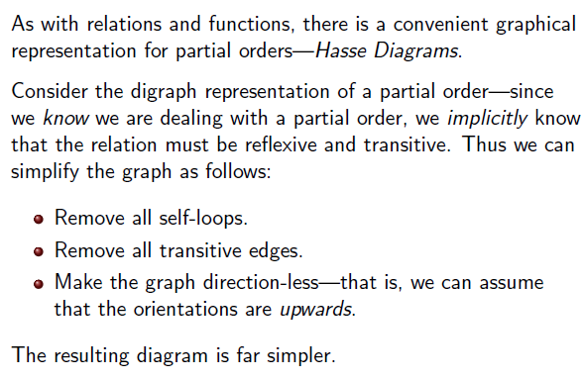
Hasse Diagrams

Slide 114
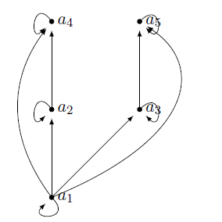
Hasse Diagram Example

Slide 115
Example 12.
Draw the Hasse diagram representing the partial ordering {(a, b) | a divides b} on {1, 2, 3, 4, 6, 8, 12}.
Sol :
8
12
4
6
2
3
1

Slide 116
Example 13.
Draw the Hasse diagram for the partial ordering {(A, B) | A ⊆ B} on the power set P(S) where S={a, b, c}.
Sol :
{a, b, c}
{a, b}
{a, c}
{b, c}
{a}
{b}
{c}
∅

